Slide 1

cyber Opportunities contest A Toolkit for Federal Agencies
Pre-508

Slide 2
Cyber OPPORTUNITIES contest
Contest Overview
OVERVIEW
The Federal Cyber Workforce Management and Coordinating Working Group in partnership with Open Opportunities, established the Cyber Professionals Community (CPC) to serve as a central hub to post and participate in development opportunities. The community can be found at: https://openopps.usajobs.gov/communities/5.
JOIN THE CONTEST
To expand awareness about this Community and in celebration of Cybersecurity Awareness Month, the Working Group is hosting an interagency contest.
WHEN
10/3 is the official kick of the contest and will wrap up by 12/2. No enrollment is necessary!
During this time period, any activity in the Cyber Professionals Community will automatically qualify as participation in the contest.
WHO
Everyone is welcomed and encouraged to participate:
Workforce professionals, including trainers, learning development, and HR specialists
Hiring Managers, Supervisors
Cyber practitioners (incoming and current)
HOW
Become a CPC member and participate by:
Joining the community
Posting and applying for opportunities
Participating in discussion boards​
CONTEST DETAILS
Anyone who participates during the contest window will be entered to win and eligible for a prize per winning guidelines.
WINNERS
There will be a total of 4 winners for the contest - 2 agencies and 2 individuals.
Agencies will be selected based on:
# of opportunities posted ​
# of people who join the CPC from an agency
Individuals will be selected based on:
# of participant/applicant responses for a single cyber opportunity posted
# of entries on the CPC discussion board
POTENTIAL PRIZES*
Potential prizes for agencies and individuals include the following:
A profile of each winning employee or agency in the Open Opportunities Newsletter​
Congratulatory meeting with the Office of National Cyber Director (ONCD)​ and Councils (i.e., Chief Human Officer, Chief Learning Officer, and/or Chief Information Officer)
Shoutout on LinkedIn
*The above are subject to availability and resources.
Pre-508

Slide 3




Getting started
Toolkit Overview
We need YOUR HELP!
USING THE TOOLKIT
The enclosed information and resources can be used to promote and engage participation in the Cyber Opportunities Contest and Community at large.
WHAT’S INCLUDED
Distribute the ready-to-use materials in speaking events, newsletters, posts, and 1-1 or group discussions, etc. Personalize any sample messaging to help spread the word.
Quick Links to Toolkit Resources
Sample Communication Messages: Emails, Blogs, Website Posts
Promotional Materials: Informational Posters, Desk Drops, Slick Sheets
FAQs on the Contest and the Cyber Professionals Community
WHAT YOU CAN DO
As a contest ambassador, you can:
Educate others about the Community’s value.
Encourage posting and participation in the opportunities.
Search for quick plug-ins to share contest details.
Post opportunities.
Engage in the discussion boards.
Participate in the posted opportunities.
The Cyber Professionals Community (CPC) helps agencies connect cyber professionals to development opportunities that build, deepen, or expand their skill sets.
CREATE CONNECTIONS
Bring people together across agencies and the federal space.
CENTRALIZE OPPORTUNITIES
Streamline where to post and find development opportunities
SUPPORT CAREER DEVELOPMENT
Cultivate cyber career development and mobility in the federal government
Have Questions? Reach out to the Working Group.

Slide 4
SAMPLE MESSAGING
Feel free to use any of the email sample messaging to reach out to your networks.
Sample email message #1 – to cyber leaders
Sample email message #2 – to cyber professionals
Sample email message #3 – to potential contest ambassadors
Sample website, blog, and newsletter messaging

Slide 5



SAMPLE EMAIL MESSAGE 1
Sample Messages
Targeted Recipients: Workforce Practitioners, Cyber Hiring Managers, and Supervisors
To: [Appropriate Listserv]
Subject: Happy Inbox – A Special Announcement!
Dear Colleagues,
In celebration of Cybersecurity Awareness Month, the Federal Cyber Workforce Management and Coordinating Working Group, in partnership with Open Opportunities, is hosting an interagency contest (see attached) to promote cyber skill and career development.
How to get involved
Create an account and join the Cyber Professionals Community (CPC) – a network of professionals looking to connect, share knowledge, or fill and find their next development opportunities.
From now to 12/2, post and fill cyber development opportunities to the CPC such as micro assignments, rotational assignments, special projects – even volunteer work!
Exchange knowledge in the CPC by engaging and responding to discussion board topics.
Get other involved by spreading the word and sharing with others in your network and upcoming agency events.
The Working Group will announce 4 winners by no later than December 30, 2022. Winners will be eligible for various prizes – don’t miss out!
Have questions? Reach out to the Working Group or Open Opportunities Team.
Sincerely,
[Name]
Quick Tips:
Check out the Informational Posters
Tap listservs with targeted recipients.
Share the posters.
Return to Toolkit List
Plug-in at speaking events.

Slide 6
SAMPLE EMAIL MESSAGE 2
Sample Messages
Targeted Recipients: Incoming and Current Cyber Professionals
To: [Appropriate Listserv]
Subject: We See Something Awesome in Your Future!
Dear Colleagues,
In celebration of Cybersecurity Awareness Month, the Federal Cyber Workforce Management and Coordinating Working Group, in partnership with Open Opportunities, is hosting an interagency contest (see attached) to promote cyber skill and career development.
Finding professional development opportunities can be tough. We made it easy with this contest and our one-stop Cyber Professionals Community. Go ahead – click and expand your network; grow your knowledge and skills; and achieve your next career goal. It’s too easy not to!
Here’s how to get started:
Create an account and join the Cyber Professionals Community.
From now until 12/2, apply for available cyber development opportunities such as micro assignments, rotational assignments, special projects – even volunteer work!
Exchange knowledge by engaging and responding to discussion board topics.
Get others involved by spreading the word and sharing with your network.
The Working Group will announce 4 winners by no later than December 30, 2022. Winners will be eligible for various prizes – don’t miss out!
Questions? Reach out to the Working Group or Open Opportunities Team.
Sincerely,
[Name]
Quick Tips:
Check out the Informational Posters
Pass along in employee development discussions.
Share with new hires and mentees.
Return to Toolkit List
Include in employee resources.

Slide 7
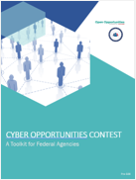
Sample email message 3
Sample Messages
Targeted Recipients: Potential Contest Ambassadors
To: [ Appropriate Listserv]
Subject: We Need Your Voice!
Dear Colleagues,
In celebration of Cybersecurity Awareness Month, the Federal Cyber Workforce Management and Coordinating Working Group, in partnership with Open Opportunities, is hosting an interagency contest (see attached) to promote cyber skill and career development.
We need your voice to encourage, educate, and get the word out about this contest on the Cyber Professionals Community – a network of professionals looking to connect, share knowledge, and fill or find professional development opportunities. Help close the current skills gaps by serving as a contest ambassador.
Enclosed in this toolkit, you will find several resources to help you engage in speaking events and discussions, share across your network, and champion this contest and the Cyber Professionals Community. We’ve included information such as:
Contest Details
Cyber Professionals Community Overview
Answers to FAQs
One-Page Fact Sheets
Ready-to-Use Messaging
Have questions? Reach out to the Working Group or Open Opportunities Team.
Sincerely,
[Name]
Quick Tip:
Find other contest ambassadors and share the ENTIRE toolkit.
Check out the Informational Posters
Return to Toolkit List
Pre-508

Slide 8
SAMPLE WEBSITE AND NEWSLETTER MESSAGING
Sample Messages
In celebration of Cybersecurity Awareness Month, the Federal Cyber Workforce Management and Coordinating Working Group, in partnership with Open Opportunities, is launching an interagency contest to promote cyber skill and career development. No enrollment is necessary!
Collaborate, share, and connect with others. Whether you’re a cyber professional, hiring manager, supervisor, or workforce practitioner, everyone is welcomed. There are 3 easy ways to get involved.
Join the Cyber Professionals Community and…
Post a variety of development opportunities – let’s close the cyber skills gap!
Pursue available development opportunities – it’s time to develop up!
Share the linked toolkit below and its resources – help get the word out!
The Working Group will announce 4 winners by no later than December 30, 2022. Winners will be eligible for various prizes.
Click here to download the toolkit to learn more about the contest, community, and ways to champion and message across your network.
*Note the toolkit will need to be uploaded and/or accessible. Please connect with the appropriate POCs at your agency to coordinate.
Quick Tips:
Check out the Informational Posters
Share on cyber intranet pages, newsletters, groups, etc.
Post on available social media accounts and channels.
Return to Toolkit List
Pre-508

Slide 9
Informational Posters
Feel free to attach and share the posters with your networks.
Informational poster #1 – contest overview
Informational poster #2 – Cyber Professionals Community overview
Informational poster #3 – contest overview (image/ social media)
Informational poster #4 – contest frequently asked questions

Slide 10
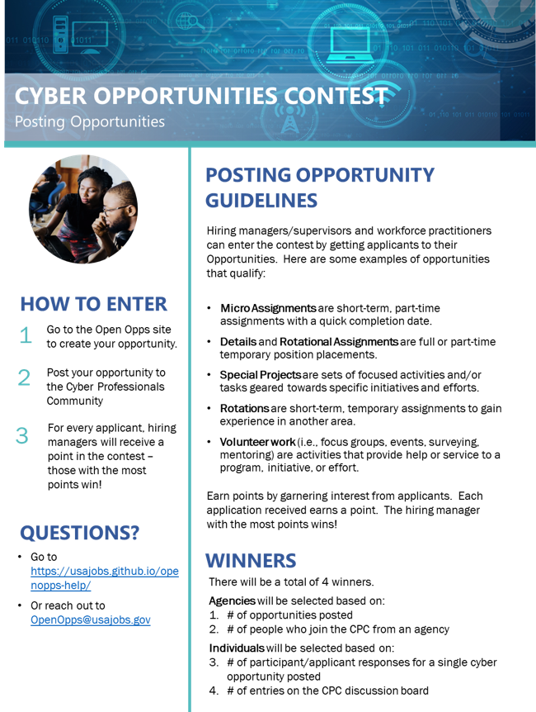
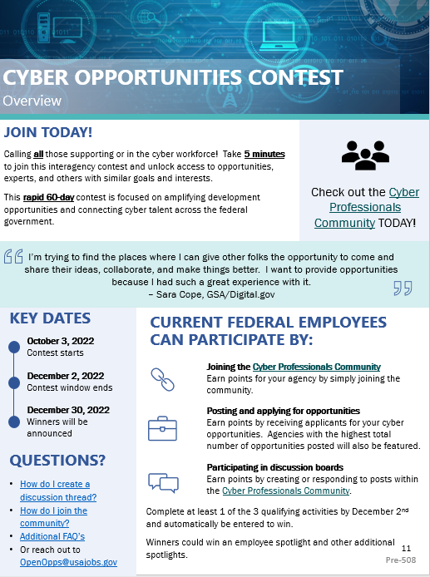
INFORMATIONAL POSTER 1
Informational Posters
This poster provides an overview of the contest. It can be attached as a PDF or copied and pasted to an email.
Go to Sample Messages
Return to Toolkit List
Pre-508

Slide 11




CYBER OPPORTUNITIES CONTEST Overview
JOIN TODAY!
Calling all those supporting or in the cyber workforce! Take 5 minutes to join this interagency contest and unlock access to opportunities, experts, and others with similar goals and interests.
This rapid 60-day contest is focused on amplifying development opportunities and connecting cyber talent across the federal government.
Check out the Cyber Professionals Community TODAY!
I was doing work in a way I hadn’t before, and I got to meet so many incredible people.
– Railyn Stokes, U.S. Department of the Interior
KEY DATES
October 3, 2022
Contest starts
December 2, 2022
Contest window ends
December 30, 2022
Winners will be announced
CURRENT FEDERAL EMPLOYEES CAN PARTICIPATE BY:
Joining the Cyber Professionals Community
Earn points for your agency by simply joining the community.
Posting and applying for opportunities
Earn points by receiving applicants for your cyber opportunities. Agencies with the highest total number of opportunities posted will also be featured.
QUESTIONS?
How do I create a discussion thread?
How do I join the community?
Additional FAQ’s
Or reach out to OpenOpps@usajobs.gov
Participating in discussion boards​
Earn points by creating or responding to posts within the Cyber Professionals Community.
Complete as many qualifying activities by December 2nd and automatically be entered to win.
Winners could win an employee spotlight and other prizes.

Slide 12

CYBER OPPORTUNITIES CONTEST Development Opportunities
DEVELOPMENT OPPORTUNITY GUIDELINES
Participants can enter the contest by posting, applying, and/or fulfilling development opportunities.
Here are some examples of opportunities that qualify:
HOW TO ENTER
Go to the Open Opportunities site and sign-up.
Join the Cyber Professionals Community.
Actively participate in the Community by posting or filling opportunities and talking – those with the most points win!
Micro Assignments ​are short-term, part-time assignments with a quick completion date.
Details are full or part-time temporary position placements.
Special Projects are sets of focused activities and/or tasks geared towards specific initiatives and efforts.
Rotational Assignments are short-term, temporary assignments to gain experience in another area.
Volunteer work (i.e., focus groups, events, surveying, mentoring) are activities that provide help or service to a program, initiative, or effort.
1
2
3
Earn points by engagement – posting and fulfilling opportunities – even responding on discussion boards! Each activity earns a point. Those with the most points wins!
QUESTIONS?
How do I post an opportunity?
How do I extend an offer?
How do I join the community?
How do I write a great opportunity?
Additional FAQ’s
Or reach out to OpenOpps@usajobs.gov
WINNERS
There will be a total of 4 winners.
Agencies will be selected based on:
# of opportunities posted ​
# of people who join the CPC from an agency
Individuals will be selected based on:
# of participant/applicant responses for a single cyber opportunity posted
# of entries on the CPC discussion board
Pre-508

Slide 13
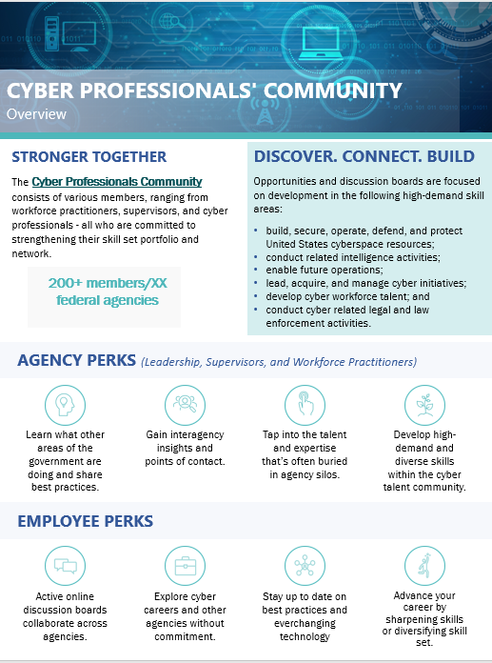
INFORMATIONAL POSTER 2
Informational Posters
This poster highlights the value of the Cyber Professionals Community. It can be attached as a PDF or copied and pasted to an email.
Go to Sample Messages
Return to Toolkit List
Pre-508

Slide 14








CYBER PROFESSIONALS' COMMUNITY Overview
STRONGER TOGETHER
The Cyber Professionals Community consists of various members, ranging from workforce practitioners, supervisors, and cyber professionals - all who are committed to strengthening their skill set portfolio and network.
DISCOVER. CONNECT. BUILD
Opportunities and discussion boards are focused on development in the following high-demand skill areas:
build, secure, operate, defend, and protect United States cyberspace resources;
conduct related intelligence activities;
enable future operations;
lead, acquire, and manage cyber initiatives;
develop cyber workforce talent; and
conduct cyber related legal and law enforcement activities.
200+ members/XX federal agencies
AGENCY PERKS (Leadership, Supervisors, and Workforce Practitioners)
Learn what other areas of the government are doing and share best practices.
Gain interagency insights and points of contact.
Tap into the talent and expertise that’s often buried in agency silos.
Develop high-demand and diverse skills within the cyber talent community.
EMPLOYEE PERKS
Active online discussion boards collaborate across agencies.
Explore cyber careers and other agencies without commitment.
Stay up to date on best practices and everchanging technology
Advance your career by sharpening skills or diversifying skill set.

Slide 15
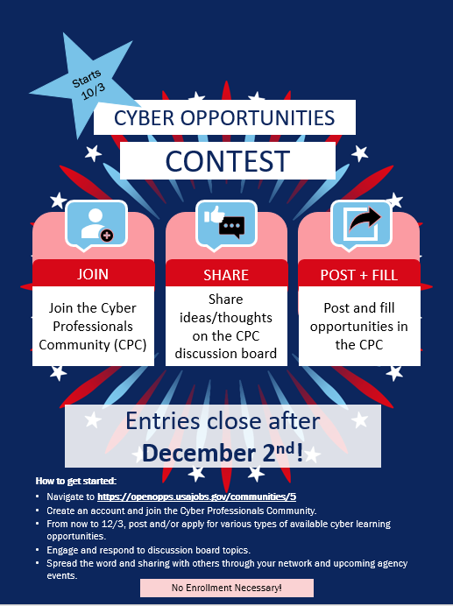
INFORMATIONAL POSTER 3
Informational Posters
This poster promotes the Cyber Opportunities Contest. It can be attached as a PDF or copied and pasted to an email.
Go to Sample Messages
Return to Toolkit List
Pre-508

Slide 16
Cyber Opportunities Contest Informational Poster
Starts 10/3
CYBER OPPORTUNITIES
CONTEST
JOIN
SHARE
POST + FILL
Join the Cyber Professionals Community (CPC)
Share ideas/thoughts on the CPC discussion board
Post and fill opportunities in the CPC
Entries close after December 2nd!
How to get started:
Navigate to https://openopps.usajobs.gov/communities/5
Create an account and join the Cyber Professionals Community.
From now to 12/3, post and/or apply for various types of available cyber development opportunities.
Engage and respond to discussion board topics.
Spread the word and sharing with others through your network and upcoming agency events.
No Enrollment Necessary!

Slide 17
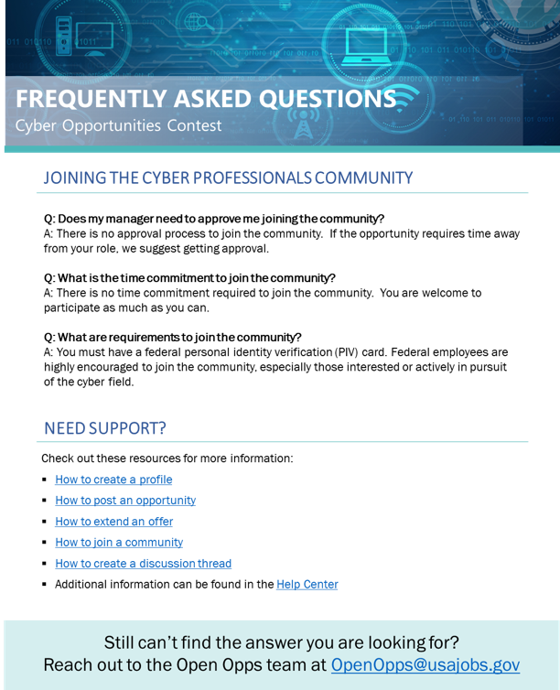
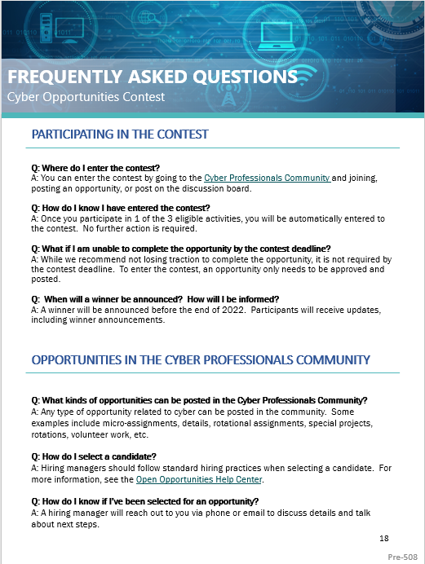
Frequently asked questions
Informational Posters
This provides answers to questions about the Cyber Professionals Community and Cyber Opportunities Contest. It can be attached as a PDF or copied and pasted to an email.
Go to Sample Messages
Return to Toolkit List
Pre-508

Slide 18
FREQUENTLY ASKED QUESTIONS Cyber Opportunities Contest
PARTICIPATING IN THE CONTEST
Q: Where do I enter the contest?
A: You can enter the contest by going to the Cyber Professionals Community and joining, posting an opportunity, or post on the discussion board.
Q: How do I know I have entered the contest?
A: Once you participate in 1 of the 3 eligible activities, you will be automatically entered to the contest. No further action is required.
Q: What if I am unable to complete the opportunity by the contest deadline?
A: While we recommend not losing traction to complete the opportunity, it is not required by the contest deadline. To enter the contest, an opportunity only needs to be approved and posted.
Q: When will a winner be announced? How will I be informed?
A: A winner will be announced before the end of 2022. Participants will receive updates, including winner announcements.
OPPORTUNITIES IN THE CYBER PROFESSIONALS COMMUNITY
Q: What kinds of opportunities can be posted in the Cyber Professionals Community?
A: Any type of opportunity related to cyber can be posted in the community. Some examples include micro-assignments, details, rotational assignments, special projects, rotations, volunteer work, etc.
Q: How do I select a candidate?
A: Hiring managers should follow standard hiring practices when selecting a candidate. For more information, see the Open Opportunities Help Center.
Q: How do I know if I’ve been selected for an opportunity?
A: A hiring manager will reach out to you via phone or email to discuss details and talk about next steps.
Pre-508

Slide 19
FREQUENTLY ASKED QUESTIONS CONT. Cyber Opportunities Contest
JOINING THE CYBER PROFESSIONALS COMMUNITY
Q: Does my manager need to approve me joining the community?
A: There is no approval process to join the community. If the opportunity requires time away from your role, we suggest getting approval.
Q: What is the time commitment to join the community?
A: There is no time commitment required to join the community. You are welcome to participate as much as you can.
Q: What are requirements to join the community?
A: You must have a federal personal identity verification (PIV) card. Federal employees are highly encouraged to join the community, especially those interested or actively in pursuit of the cyber field.
NEED SUPPORT?
Check out these resources for more information:
How to create a profile
How to post an opportunity
How to extend an offer
How to join a community
How to create a discussion thread
Additional information can be found in the Help Center
Still can’t find the answer you are looking for?
Reach out to the Open Opportunities Team at OpenOpps@usajobs.gov
Pre-508

Slide 20
Questions? (1 of 2)
Contacts
Find your assigned agency point of contact (POC) to ask questions about the Cyber Opportunities Contest.
Agency | Assigned POC
Agency for International Development | Kari Szakal
Department of Agriculture | Antoinetta Scott
Department of Commerce | Keenan Emmitt
Department of Defense | Charles Williams
Department of Education | Kari Szakal
Department of Energy | Donovan Wilson
Department of Health and Human Services | Sharon Atteh-Chi
Department of Homeland Security | Charles Williams
Department of Housing & Urban Development | Ashley Hoffman
Department of the Interior | Lance Kelson
Department of Justice | Berwyn Gonzalvo
Department of Labor | Jennifer Yee & Nichayla Porreca
Department of State | Sharon Atteh-Chi

Slide 21
Questions? (2 of 2)
Contacts
Find your assigned agency point of contact (POC) to ask questions about the Cyber Opportunities Contest.
Agency | Contact
Department of Transportation | Keenan Emmitt
Department of the Treasury | Jennifer Yee & Nichayla Porreca
Department of Veterans Affairs | Jennifer Yee & Nichayla Porreca
Environmental Protection Agency | Donovan Wilson
General Services Administration | Keenan Emmitt
National Aeronautics and Space Administration | Keenan Emmitt
National Science Foundation | Sharon Atteh-Chi
Nuclear Regulatory Commission | Kathy Lyons-Burke
Office of Personnel Management | Berwyn Gonzalvo & Keenan Emmitt
Small Business Administration | Kari Szakal
Social Security Administration | Patrice Burnett
Non-CFO Act Agencies | Charles Williams

